Slide 1
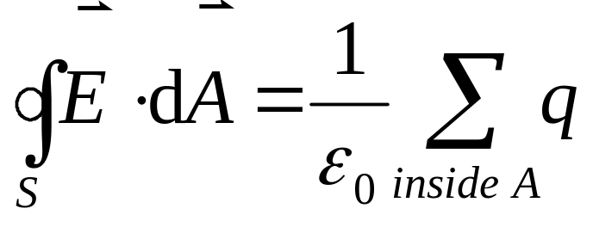
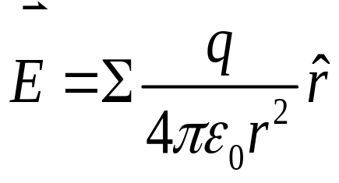
Gauss’ Law
The total flux of an electric field through a closed surface is directly proportional the net charge enclosed by this surface:
Gauss’ law is more general than Coulomb’s law.
Coulomb’s law

Slide 2








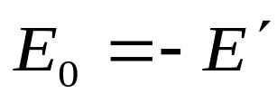
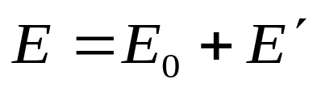
Gauss’ Law and conductors
Before entering the electric field, the conductor is electricity-neutral, although there are about 10²³ free electrons within it.
When entering the external
electric field E₀, the field will exerts a force F=-eE₀ on electrons.
The electrons quickly move to the left surface of the conductor, leaving a deficiency of electrons on the right surface (induction charges).
When the E' is equal to E₀, the electrons is not moving. This is Electrostatic equilibrium .
Within the conductor, the induction field E' is opposite to E₀.
The net field in the conductor is,

Slide 3
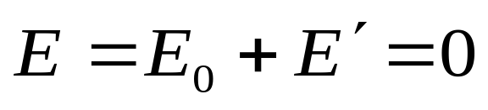
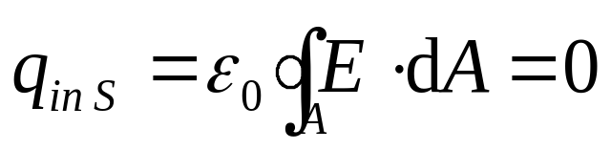
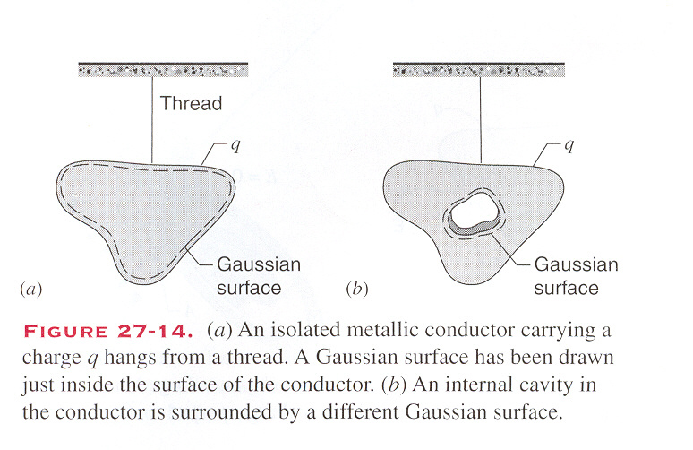
Therefore, the electrostatic equilibrium is achieved only if, everywhere inside the conductor.
2. The properties of the isolated conductors in electrostatic equilibrium
For a conductor having an internal cavity
There is no charge in the interior of the conductor.
The excess charge must be on the actual outer surface of the conductor.

Slide 4
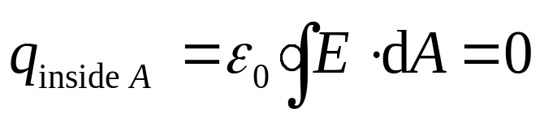
Therefore, the electrostatic equilibrium is achieved only if, everywhere inside the conductor.
2. The properties of the isolated conductors in electrostatic equilibrium
For a conductor having an internal cavity
Gauss’ law implies that there is no net charge on the surface of the interior cavity
There is no charge in the interior of the conductor.
The excess charge must be on the actual outer surface of the conductor.
If there is an object with charge q inside the cavity

Slide 5
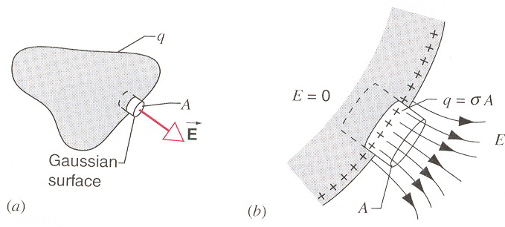
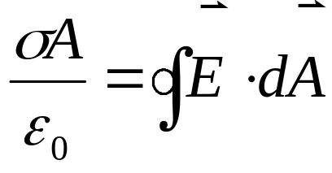
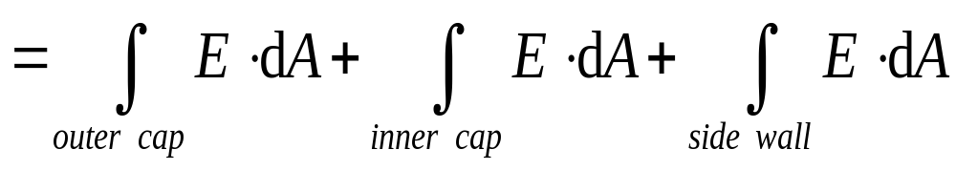
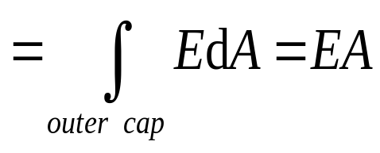
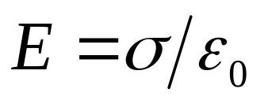
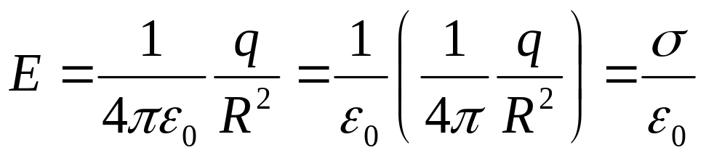
On conductor’s surface
By considering the following cylinder as Gaussian surface
Example: For a conducting sphere,
E

Slide 6
Example
-
+
-
+
-
+
-
+
-
E
-
+
-
+
-
+
-
+
-
+
-
+

Slide 7
Example
+
+
+
-
+
+
-
-
-
-
+
+
-
-
-q’
+q’
+
-
-
+
+q’
-
-
+
+
-
-
-
-
+
+
-
+
+
+

Slide 8
Example
-
-
-
-
-
-
-
-q’
-
-
+q’
-
-
-
-
-
-
-

Slide 9
Example
-
-
-
-
-
-
-
-q’
-
-
+q’
-
-
-
-
-
-
-

Slide 10
Example
-
-
-
-
-
-
-
-q’
-
-
-
-
-
-
-
-
-

Slide 11
Example
-
-
q<q’
+
+
-
+
-
-
-
+
+
-
-
-
-
-
-
-q’
+
+
-
-
q-q’
-
-
-
+
-
+
+q
-q
-
-
-
-
+
+
-
-
-
-
-
+
+
-
-
+
+
-
+
-
-

Slide 12
Example
q>q’
q=q’
+
+
+
-
+
+
-
-
-
-
-q’
+
+
-
-
q-q’
+
-
-
+
+q
-q
-
-
+
+
-
-
-
-
+
+
-
+
+
+

Slide 13
Example
q<q’
q=q’
-
-
-
-
-
-q’
-
-
q-q’
-
-
+q
-q
-
-
-
-
-
-
-

Slide 14
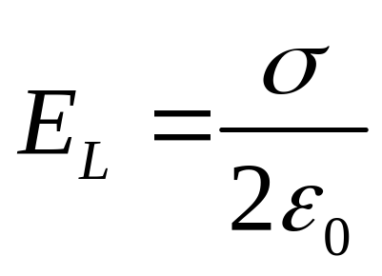
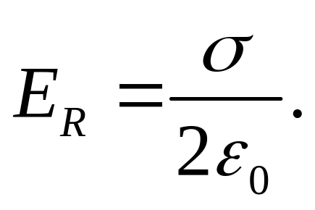
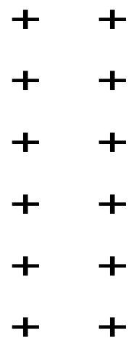
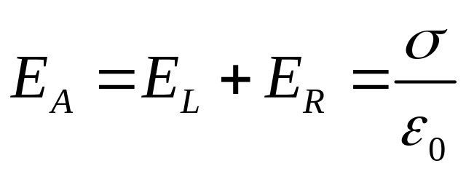
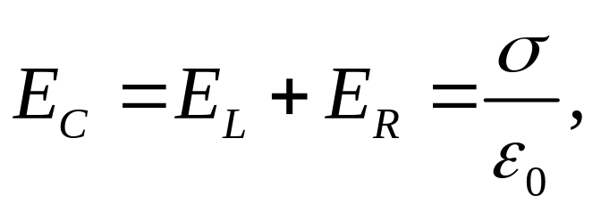
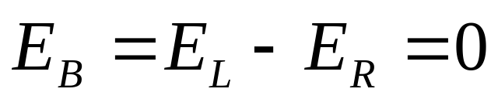
L R
E_{L}
E_{L}
E_{L}
E_{R}
E_{R}
E_{R}
A B C

Slide 15
Chapter 28 Electric Potential Energy and Potential

Slide 16
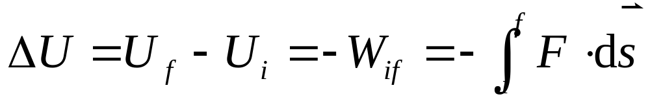

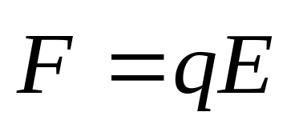
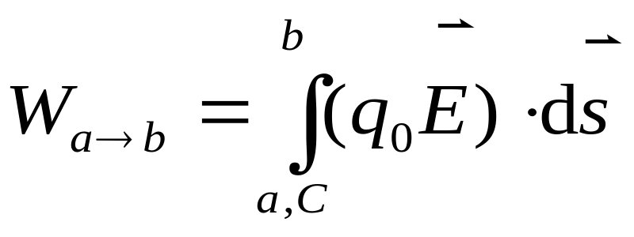
Potential Energy
In a given external electric field
b
A point charge q accepts a force
c
a

Slide 17
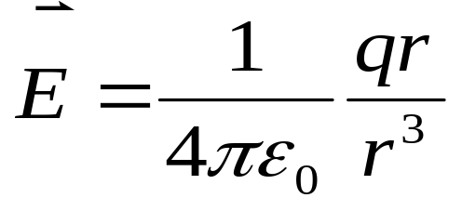
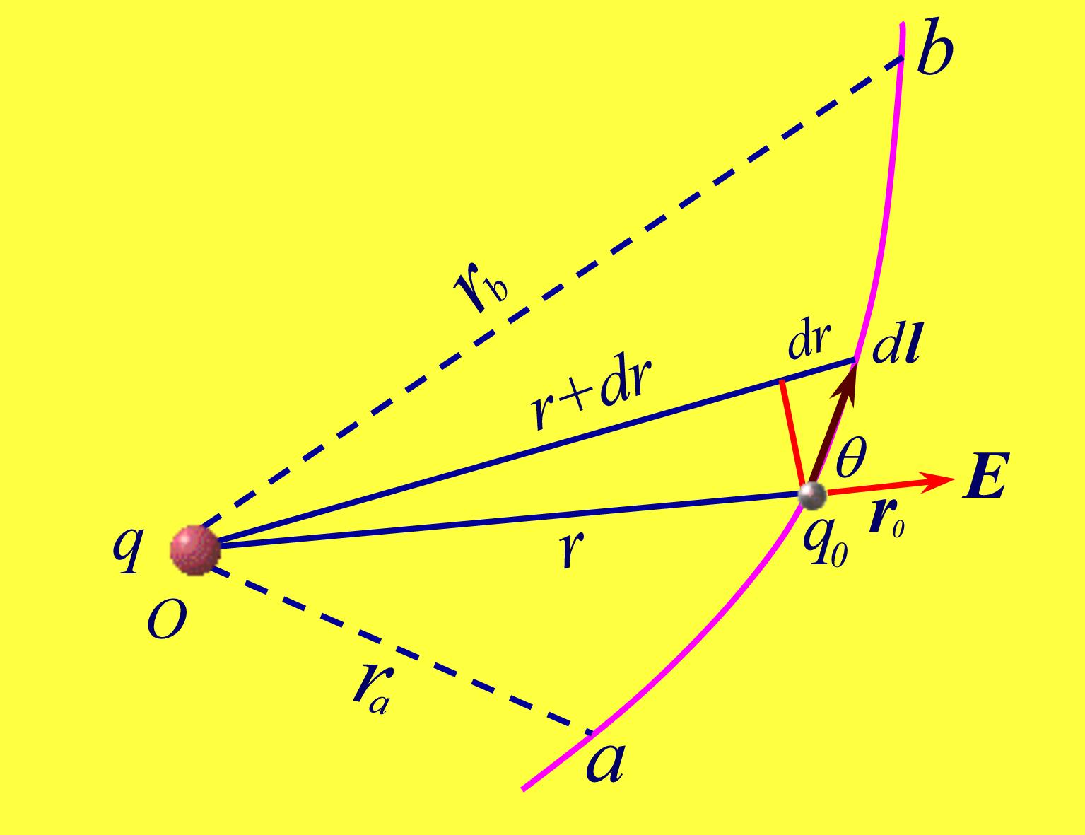
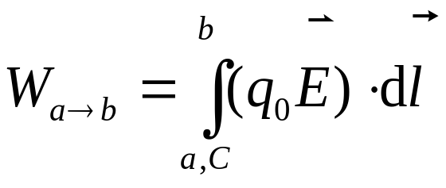
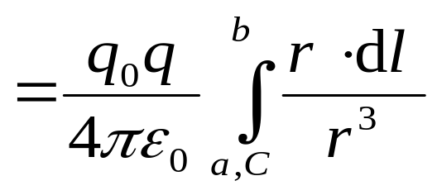
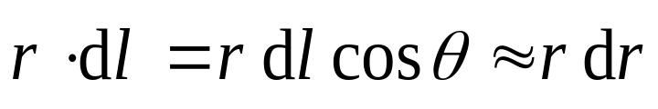
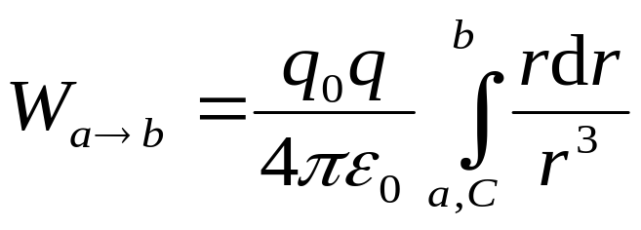
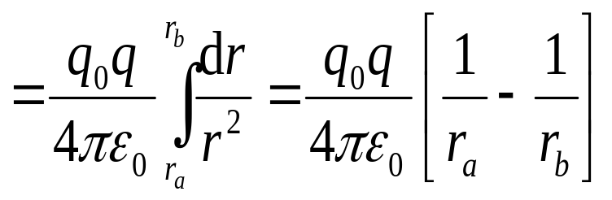
In field of a point charge q :
The work is independent on the path.

Slide 18
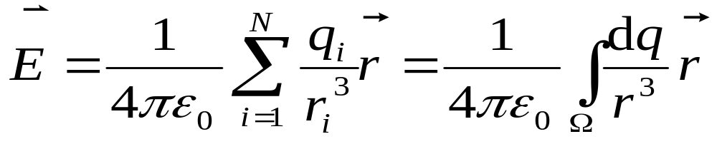
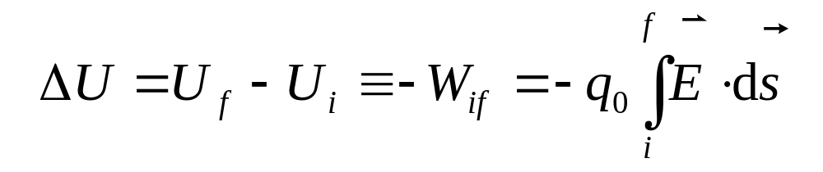
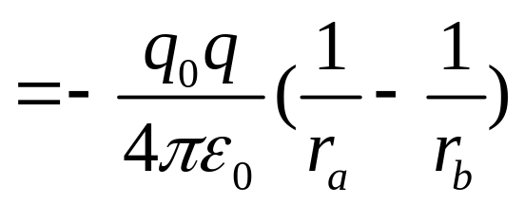

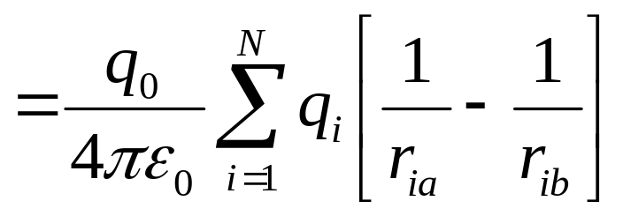
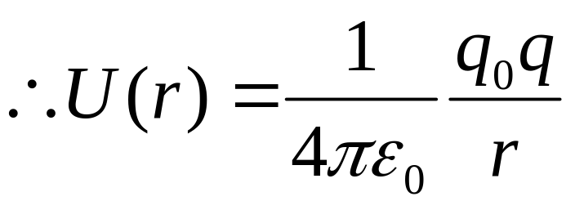
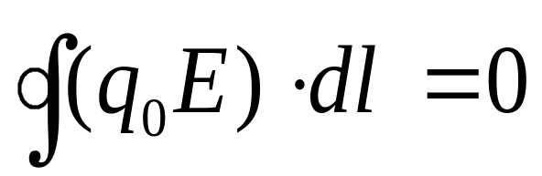
Therefore, the electrostatic force is among the conservative forces.
In field of a collection of point charges
We can define the “ electric potential energy ” to measure the work done by electrostatic force
Ω is the region of the charge distribution.
Generally, we choose a reference point, U_{a}=0.
The work does not depend on path also.
The electric field lines do not form the closed curves.

Slide 19
Conservation of energy in electrostatics
For an isolated system, E = K+U = constant.
Thus, ∆K+ ∆U=0
q₁
q₂
If two charges have opposite sign
Two charges have the same sign, ∆U<0, ∆K>0.
v
∆U>0, ∆K<0.
q₁
q₂
v
∆U<0, ∆K>0.
∆U>0, ∆K<0.
If there are external agents to move q₂, ∆K+ ∆U=W.

Slide 20
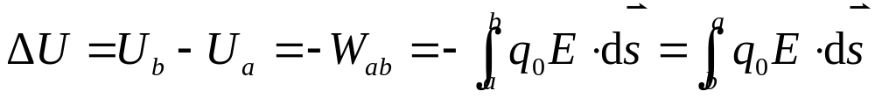
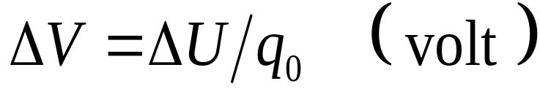
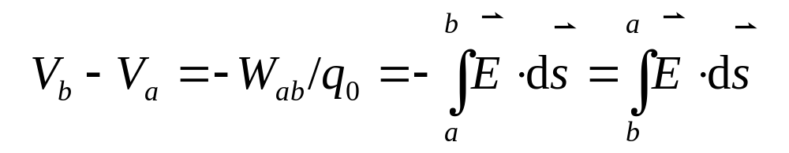

The potential energy change ∆U is directly proportional to the test charge q₀ .
Electric Potential
Define electric potential difference:
When the charge distribution is confined in a finite region, we usually choose the vanishing potential at infinity. Then
∆V is independent of the test charge q₀ .
Thus,
Generally, we choose a reference point, V_{a}=0.
The electric potential at a point is equal to the work done by electric force when to move a unit positive point charge from this point to the potential zero point.
Electric potential V may be positive, negative, or zero.
Electric potential is another quantity describing character of electric field.

Slide 21
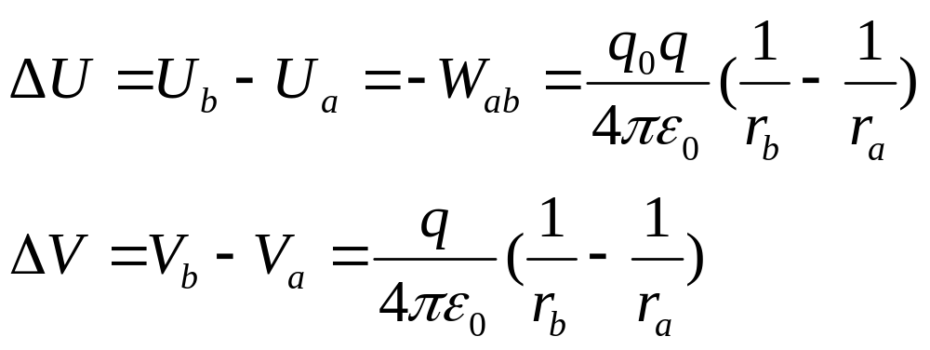
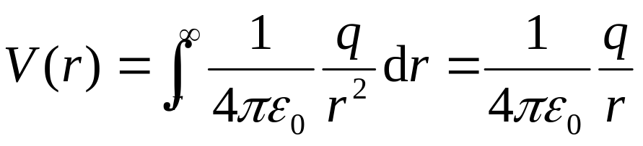
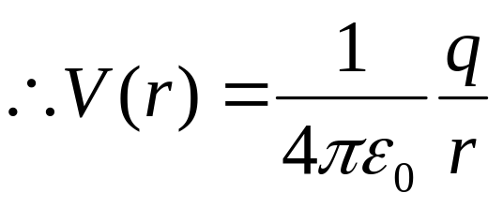
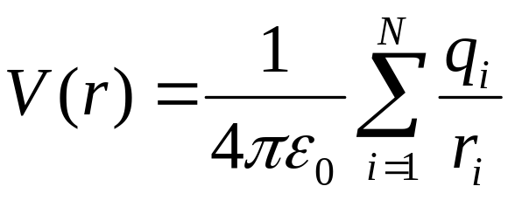
Potential Due to Point Charges
If we choose the vanishing potential at infinity,
Potential due to a collection of point charges

Slide 22
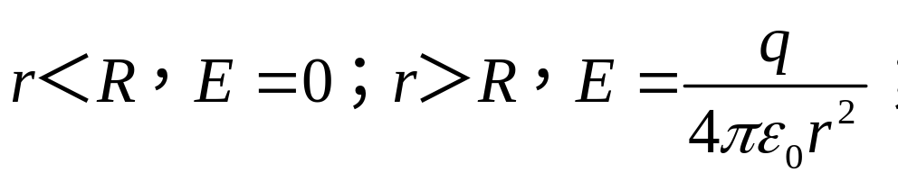
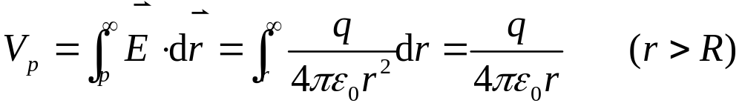
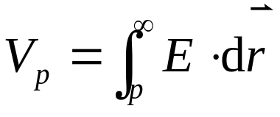
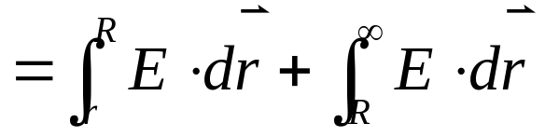

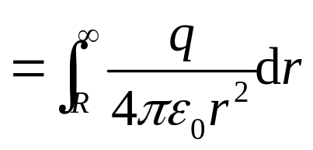
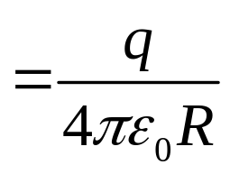
Example: a charged spherical shell with q and radius R, find the distribution of potential.
q
R

Slide 23
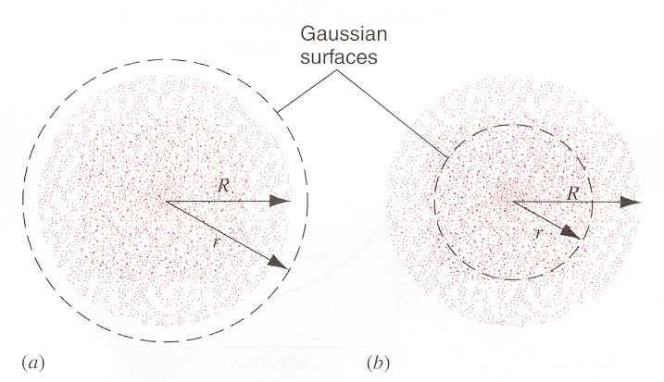












Spherically symmetric charge distribution
Suppose that the total charge on the sphere is q,
In case of R<r<∞,
In case of

Slide 24




Potential due to an electric dipole

Slide 25



Electric Potential of Continuous
Charge Distributions
1 A uniform line of charge

Slide 26


2 A ring of charge

Slide 27


3 A charged disk

Slide 28
Exercises
P 630 26, 27
P 656 13
P 657 27, 29

Slide 29






Calculate the Field From the Potential
A point positive charge q₀ moves from point a (potential V ) to point b (potential V+ΔV ) along Δs,
-q₀ΔV=
- ΔU=
W=F_{s}Δs=q₀E_{s}Δs
- q₀ΔV =q₀E_{s}Δs
The component of the electric field in any direction is the negative of the derivative of the potential with respect to a displacement in that direction.

Slide 30












In Cylindrical coordinate system
In Spherical coordinate system

Slide 31




Example:
in Cylindrical coordinates

Slide 32




Equipotential Surface
A surface on which the potential has the same value everywhere is called equipotential surface.
If not
E
It is not an equipotential surfaces
The electric field lines must everywhere be perpendicular to the equipotential surfaces.
Why?

Slide 33





The Potential of a Charged Conductor
The third property of conductors in the electrostatic field: the entire conductor is at the same potential.
Example: A charged spherical conductor, charge q and radius R.
+
+
+
+
+
+
+
+
V
+
+
+
+
+
+

Slide 34














Corona Discharge:
Model:
Consider two conducting spheres of different radii
The smaller the radius of the conducting sphere, the larger is the electric field strength just outside its surface.

Slide 35

Corona Discharge
Near a sharp conductor the electric field may be large enough to ionize molecules in the surrounding air,

Slide 36




Potential energy of a system of charges

Slide 37





Potential energy of a system of charges

Slide 38


q₂
q₁
r₁₂
Potential energy of a system of charges
r₂₃
r₁₃
q₃

Slide 39



Summary
In Cartesian coordinate system
in Spherical coordinates
in Cylindrical coordinates

Slide 40
Summary
A surface on which the potential has the same value everywhere is called equipotential surface.
The electric field lines must everywhere be perpendicular to the equipotential surfaces.
The entire conductor is at the same potential.
The smaller the radius of the conducting sphere, the larger is the electric field strength just outside its surface.
Potential energy of a system of charges

Slide 41










Example

Slide 42













Example

Slide 43










Example
λ , L
dx₁
0
x
x₁

Slide 44










example

Slide 45






example

Slide 46




example

Slide 47






example

Slide 48





example

Slide 49









example

Slide 50
Exercises
Page 657: 30, 34, 36
Page 658: 45
Problems
Page 660: 13

